Slide 1
Investigating
Context
Clues
Created by
TEACHERS UNLEASHED

Slide 2
INVESTIGATION NOTES
What are Context Clues?
Context clues are helpful words that help you figure out what difficult words mean.
Context clues can normally be found around the word you are trying to figure out the meaning to.

Slide 3
I will use these words to guide my investigation on context clues, but I still need more evidence.
INVESTIGATION NOTES
Context clues can be helping words after the difficult word, like:
that is
such as
is called
for example
or
meaning

Slide 4
Well…being a detective does mean I’m pretty smart. So I’ll just use what I know to make me a context clue expert!
INVESTIGATION NOTES
Context clues also use prior knowledge:
Prior knowledge is another way of saying “what you already know.”
Use words you already know the meaning of, to help figure the tough words out.
To be a good detective you must use prior knowledge to help make sense of messy evidence.

Slide 5
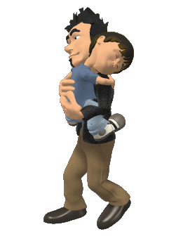
The young boy started to feel drowsy, so Dad knew that it was bedtime.
Okay…let’s look at an example.
Investigate this sentence to see if you can use the words around the bolded word to figure out what it means.
Well…I don’t know what the word drowsy means, but I’ll use what I know about context clues to help me.
It says in the sentence that it is his bedtime, and that it is a feeling. So I can conclude that drowsy means sleepy.

Slide 6
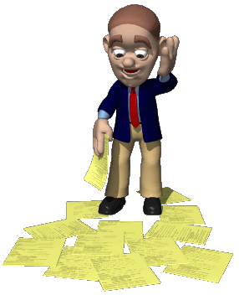
The businessman was perplexed or confused about who spilled all his papers on the floor.
Okay…let’s look at another example.
Investigate this sentence to see if you can use the words around the bolded word to figure out what it means.
It says in the sentence that someone spilled his papers, and it also uses the clue word “or” with the word confused. So I can conclude that perplexed means confused.
Well…I’m not quite sure what the word perplexed means, but I’ll use what I know about context clues to help me.

Slide 7
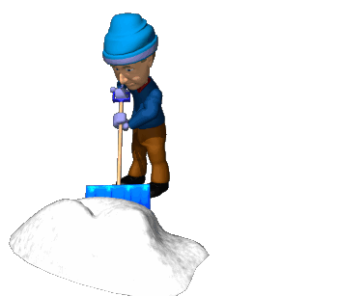
My dad despises the winter. He hates shoveling the snow in the driveway every day.
Well, well, well…..We’re doing splendidly in this investigation. Let’s take a look at another example, and use the clues we know.
It says in the sentence that dad hates shoveling the driveway in the winter. So, I don’t think that he likes winter. Despise must means that he doesn’t like or hates winter.
Uh-oh…a real tough one. I will use the words around the tough word to help me!

Slide 8
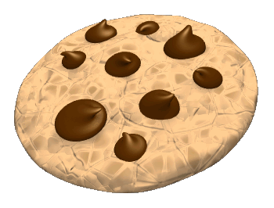
The wonderful aroma of the cookies baking in the kitchen made my mouth water.
Hmmmm…. These context clues are getting easier and easier. Keep working hard to solve this mystery.
In the sentence it talks about cookies, so I can assume they are talking about taste or smell. But, then it says the mouth watered, so I can deduce that aroma must mean smell.
Okay, well let’s look for clues in this sentence to make sense of the word aroma.

Slide 9
Alright junior detectives…now that you have gathered your evidence on how to solve context clues, let’s try and fill in the blanks with words that make sense. Be sure to look for clues in the sentence to try and find the right word.

Slide 10
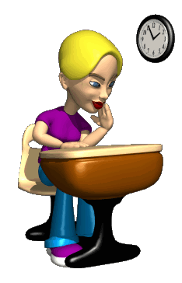
After she didn’t get a good night’s sleep, Allison felt very ______________.
Which word fits in the blank?
hungry
exhausted
energetic
smart
It says she did not sleep well, so she must be tired, but I don’t see that word. But I do see a word that means tired, the answer must be exhausted.
Okay…I need to find a word to go in the blank, but it has to make sense in the sentence.
Now let’s see if you can handle some on your own!

Slide 11
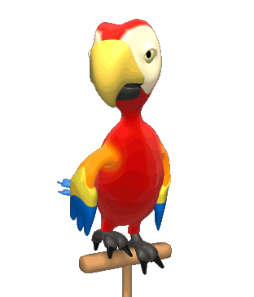
The parrot was very ____________. He could repeat words and do a dance in his cage.
Which word fits in the blank?
forgetful
sneaky
beautiful
intelligent
The sentences say that he can repeat words and dance. He must be pretty smart if he can do those things. So, which word?
Well done young detectives! Keep working hard!
Remember…the word has to make sense in the sentence.

Slide 12
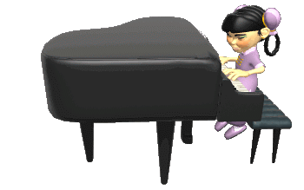
Ling is a _______ piano player. She has only had five lessons from her piano teacher.
Which word fits in the blank?
skilled
professional
beginner
excellent
Well…it says that Ling has only had five lessons, so I think that she is still learning to play the piano. What is the right word?

Slide 13
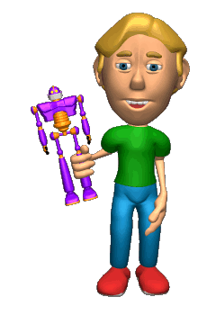
Jacob was very _______of his brother’s cool new toy robot. He wanted one too.
Which word fits in the blank?
proud
jealous
happy
upset
I think your are ready to tackle some of these on your own now, without any help from me! What’s the right word?

Slide 14
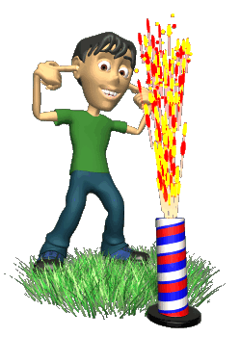
Fireworks can be very ___________. Adults need to be there with you to make sure you are safe.
Which word fits in the blank?
fun
bright
dangerous
loud
Choose the right word to go in the blank!

Slide 15
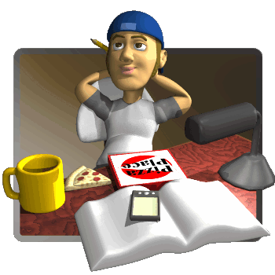
Tim could not ____________ on his homework. He was too busy thinking about girls.
Which word fits in the blank?
think
study
sleep
concentrate
Choose the right word to go in the blank!

Slide 16
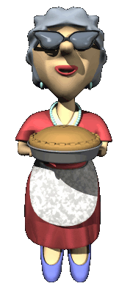
Everybody loves Marge’s pies. They are so sweet and ___________ .
Which word fits in the blank?
delicious
smelly
warm
brown
Choose the right word to go in the blank!

Slide 17
It seems that you students are turning into genuine incredible investigators. Now let’s switch back to determining what a word means by using its context clues.

Slide 18
You can only see things that are microscopic with a microscope.
What does the word microscopic mean?
(Remember to use your context clues)
large
round
tiny
purple

Slide 19
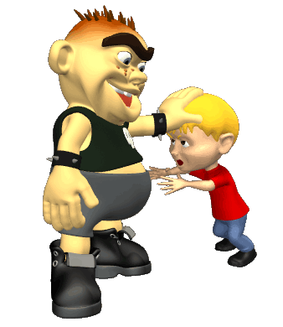
Bruno was a malicious kid, and he always picked on children smaller than himself.
What does the word malicious mean?
(Remember to use your context clues)
smart
funny
tall
unkind

Slide 20
An intelligent sleuth with the right tools would help us to solve this crime.
What does the word sleuth mean?
(Remember to use your context clues)
detective
doctor
pilot
criminal

Slide 21
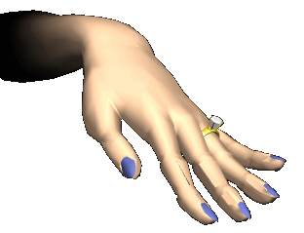
Ana’s new diamond ring would shimmer in the sunlight when she walked outside.
What does the word shimmer mean?
(Remember to use your context clues)
dull
sparkle
light
blind

Slide 22
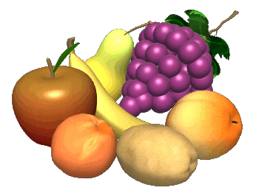
Apples, oranges, peaches, and grapes are all considered nutritious food.
What does the word nutritious mean?
(Remember to use your context clues)
tasty
yucky
fruit
healthy

Slide 23
The man went to the penitentiary for robbing the city bank.
What does the word penitentiary mean?
(Remember to use your context clues)
prison
library
hospital
bank

Slide 24
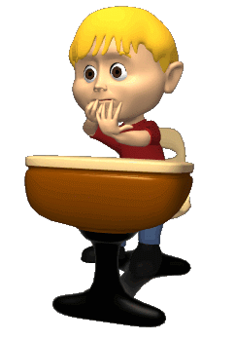
Steven was extremely anxious about the big test, but Shirley was not nervous at all.
What does the word anxious mean?
(Remember to use your context clues)
excited
scared
nervous
proud

Slide 25
The bird was very familiar to Roxy. She recognized it by the color of its’ wings.
What does the word familiar mean?
(Remember to use your context clues)
old
beautiful
annoying
well-known

Slide 26
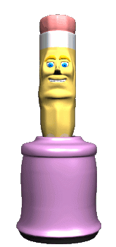
Carla found sharpening pencils very mundane. She wished she had a more exciting job.
What does the word mundane mean?
(Remember to use your context clues)
exciting
boring
thrilling
helpful

Slide 27
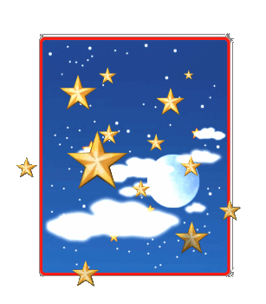
Outer space contains a vast amount of stars. You can see millions of them in the night sky.
What does the word vast mean?
(Remember to use your context clues)
small
large
dark
bright

Slide 28
I just installed a new application on my cell phone that lets me play games.
What does the word application mean?
(Remember to use your context clues)
ring tone
phone message
picture
program

Slide 29
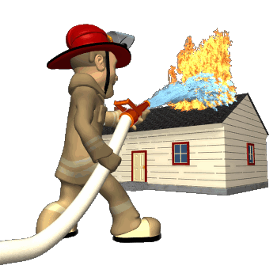
The firefighter jumped off the truck and sprayed the house with water. His actions were very valiant.
What does the word valiant mean?
(Remember to use your context clues)
cowardly
brave
important
weak

Slide 30
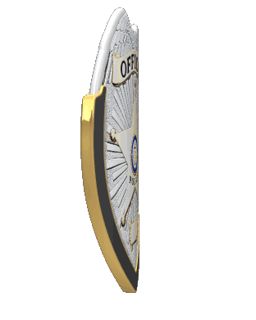
I cannot believe how far you have come. It is my pleasure to present you with your official detective badges. Now go out and enforce context clue laws!

Slide 31
Thank you for choosing
TEACHERS
UNLEASHED
To see more of our great products, please visit our store via the link below!
www.teacherspayteachers.com/Store/Teachers-Unleashed

